Slide 1

A review of the quality of care provided to adult patients towards the end of life
Key messages and recommendations

Slide 2

The Study
Study population:
Patients aged 18 or over who died in hospital between 1st April 2022 and 30th September 2022 with one or more of these conditions: dementia, heart failure, lung cancer or liver disease.
A sample of people who died in the community was also identified.
Data sources:
Clinician questionnaires
Case reviews
Organisational questionnaires data provided by NACEL
Notes:
Organisational questionnaires To reduce data burden, and to use data already collected efficiently, organisational data collected for NACEL in 2022 was shared with NCEPOD and will be used in the report. There will be no organisational questionnaire for this study.

Slide 3
Study population
Inclusion criteria :
Patients aged 18 or over who died in hospital between 1st April 2022 and 30th September 2022 with one or more of the following conditions: dementia, heart failure, lung cancer or liver disease.
A sample of people who died in the community was also identified. These were patients admitted to hospital during the study period with one of the included diagnoses who were subsequently discharged and died within six-months.
Exclusions:
Death due to suicides, homicides, or self-harm related
Death due to trauma, drowning, drug overdose or poisoning

Slide 4
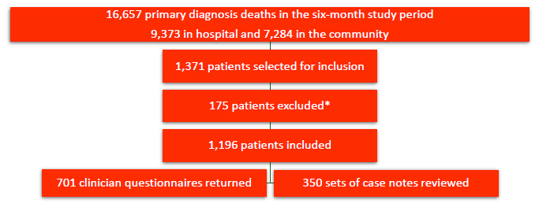
Data returns

Slide 5
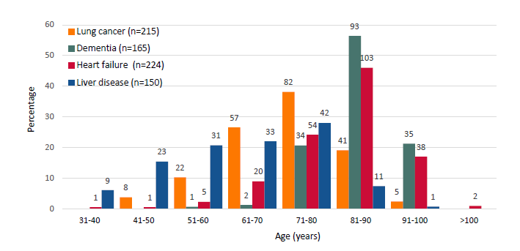
Age of patients included in the study population

Slide 6
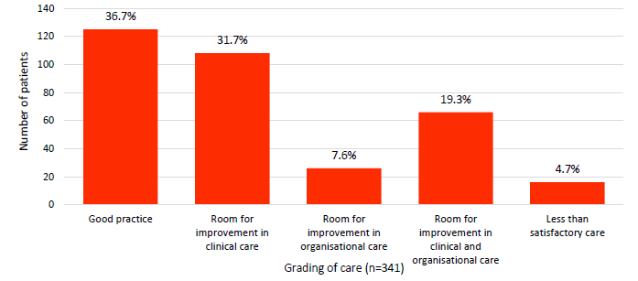
Overall quality of care

Slide 7
KEY MESSAGES

Slide 8
1
PALLIATIVE CARE IS NOT JUST ABOUT END OF LIFE CARE
Not enough patients had access to early palliative care alongside existing treatments to improve symptoms and quality of life
135/439 (30.8%) patients had parallel planning.
During the final admission, the specialist palliative care team were involved in the care of 230/446 (51.6%) patients.
Where a parallel planning approach was not taken, this linked to room for improved clinical care for 58/140 (41.4%) patients.

Slide 9
2
NORMALISE CONVERSATIONS ABOUT DEATH AND DYING
Death and dying was not discussed as often as it could have been. More people need to have their end of life care wishes recorded.
169/233 (72.5%) patients did not have their preferences for care at the end of their life recorded.
Communication was an area for improvement and of good practice. This included how patients and their families were included in decisions about care being provided, and advance care plans.

Slide 10
3
HAVE A NAMED CARE-CORDINATOR
Care co-ordinators are an accepted standard in cancer services but were less common for other advanced chronic conditions.
There was documentation of a lead person in the records of 257/396 (64.9%) patients.
When a lead person was documented, specific end of life documentation was used in 162/243 (66.7%) patients, compared with 44/134 (32.8%) where there was no lead person documented.

Slide 11
4
PROVIDE SPECIALIST PALLIATIVE CARE SERVICES IN HOSPITALS AND IN THE COMMUNITY
Specialist palliative care services were not always available in hospitals nor involved when needed.
Seven-day specialist palliative care services were available in 125/210 (59.5%) hospitals.
120/290 (41.4%) patients without parallel planning had specialist palliative care input, compared with 94/130 (72.3%) who did.
For 77/444 (17.3%) patients specialist palliative/end of life care input could have been better.

Slide 12
5
PALLIATIVE AND END OF LIFE CARE SHOULD BE A CORE COMPETENCIES
Training to identify when palliative or end of life care will help was not always provided or available.
Training in end of life care was included in the induction programme in only 137/214 (64.0%) hospitals and in mandatory or priority training in 110/214 (51.4%) hospitals.
Training in end of life care for all patient-facing healthcare staff is needed to recognise who would benefit from specialist palliative care to treat the symptoms of advanced chronic disease.

Slide 13
RECOMMENDATIONS

Slide 14
Parallel planning in advanced chronic conditions
Ensure that patients with advanced chronic disease have access to palliative care alongside disease modifying treatment (parallel planning) to improve symptom control and quality of life. Primary target audience: Integrated care boards and commissioners, hospital executive boards Supported by: Palliative care services, clinical directors, medical directors and directors of nursing, hospice services and local authorities, primary care, community care including care homes, nursing homes and social care This aligns with NICE Guideline [NG142], End of life care for adults: service delivery, 2019

Slide 15
Communication about death and dying
Normalise conversations about palliative/end of life care, advance care plans, death and dying. As a trigger to introduce a conversation which includes the patient and their family/carers, consider: • The surprise question “Would you be surprised if this patient died within the next 12-months?” This can be used across all healthcare settings; and/or • Recurrent hospital admission of patients with advanced chronic disease. Primary target audience: Patients and their families/carers, all healthcare professionals, specifically members of the clinical team treating the underlying disease, primary care, community care including care home and nursing home staff Supported by: Palliative care services, clinical directors, medical directors and directors of nursing, hospice services and social care

Slide 16
Named care co-ordinator
Ensure all patients with an advanced chronic disease are allocated a named care co-ordinator. Primary target audience: Medical directors and directors of nursing in integrated care boards, health boards and trusts Supported by: Palliative care services, clinical directors, primary care, hospice services and social care This aligns with NICE Cancer Service Guideline [CSG4] Improving Supportive and Palliative Care for Adults with Cancer

Slide 17
Specialist palliative care services provision
Provide specialist palliative care services in hospitals and in the community, to ensure all patients, including those with non-malignant diseases receive the palliative care they need. Primary target audience: Integrated care boards and commissioners Supported by: Medical directors, directors of nursing, the Association for Palliative Medicine of Great Britain and Ireland, hospice services, primary care, and community care This aligns with recommendations from the National Audit of Care at the End of Life

Slide 18
Training for patient-facing healthcare professionals
Train patient-facing healthcare staff in palliative and end of life care. This training should be included in:
• Undergraduate and postgraduate education; and
• Regular training for patient-facing healthcare staff
Primary target audience: Medical schools, schools of nursing and university departments who provide training for nurses, pharmacists, allied health professionals, primary care, community care including care homes, nursing homes, social care, post-graduate deaneries, medical directors and directors of nursing
Supported by: Executive boards, integrated care boards and commissioners, Care Quality Commission, Health Inspectorate Wales, Regulation and Quality Improvement Authority Northern Ireland
This aligns with recommendations from the National Audit of Care at the End of Life

Slide 19
Advance care plans
Ensure that existing advance care plans are shared between all providers involved in a patient’s care. This aligns with recommendation 2 from the NCEPOD report looking at the in-hospital care of out of hospital cardiac arrests – Time Matters Primary target audience: Integrated care boards and commissioners Supported by: Palliative care services, clinical directors, medical directors and directors of nursing, primary care, ambulance trusts, care home and nursing home providers, hospice services, social care, local authorities, patients, carers and family members

Slide 20
Public awareness
Raise public awareness to increase the number of people with a registered health and welfare lasting power of attorney (LPA) well before it is needed. Primary target audience: Department for Health and Social Care, Welsh Government, Department of Health Northern Ireland, Office of the Public Guardian, the Office of Care and Protection Supported by: Royal colleges, patient support groups, third sector organisations, hospice services, primary care, community care including care homes, nursing homes and social care

Slide 21
REPORT and TOOLS
http://www.ncepod.org.uk/2024eolc.html
Report
Summary
Infographic
Recommendation checklist
Audit tool
Driver diagram
Fishbone diagram
Commissioners guide

